Slide 1
Lab Reminders
1. Tie your hair back, before coming to the classroom.
2. Wash your hand (20 seconds).
3. Wear Aprons Correctly. Cross in back, bow in front.
4. Behavior and staying in your kitchen is part of your grade.

Slide 2
5. Measure Ingredients Carefully !!
6. READ the Recipe and FOLLOW Directions.
7. CHECK to make sure the measurement is correct.
8. Hang up your apron when DONE in the kitchen, then sit down at your assigned table.

Slide 3
Homework Questions
1. WHAT DID YOU DO TO HELP PREPARE THE RECIPE EACH DAY?
2. WHAT WAS YOUR CLEAN-UP JOB?
3. HOW WERE THE FOOD GROUPS REPRESENTED IN THE RECIPE?
4. DID YOU LIKE THE RECIPE? WHY OR WHY NOT?
5. DESCRIBE SOMETHING NEW YOU LEARNED FROM THIS LAB.

Slide 4
Abbreviations
t. = teaspoon, tsp.
T. = Tablespoon, Tbsp.
c. = cup

Slide 5
Measurements
Dry Ingredients
1. Use metal or nested measuring cups.
2. Heap full.
3. Level off with a straight edge spatula.
Liquid Ingredients
1. Use a glass or see-through cup.
2. Place on flat level surface.
3. Read at eye level.
Measuring Spoon – measure both liquid and dry ingredients.

Slide 6
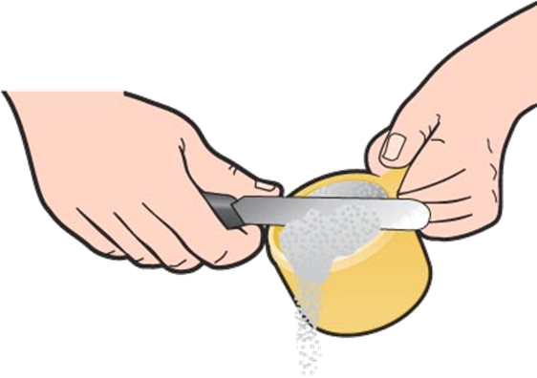
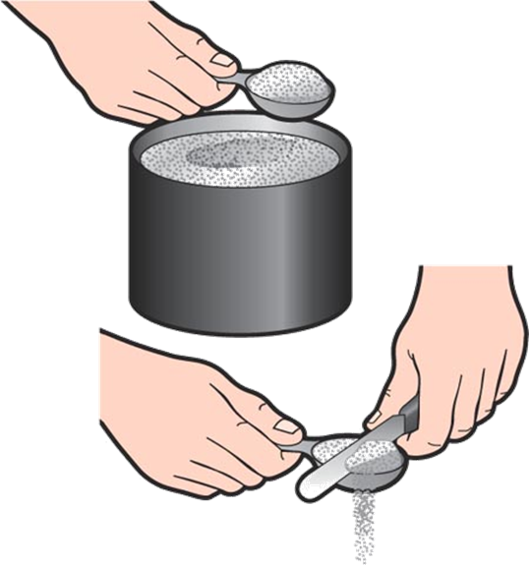
Measuring Dry Ingredients
For dry ingredients including flour, sugar, and salt, use dry measuring cups & spoons.
Heap
Level
Empty

Slide 8
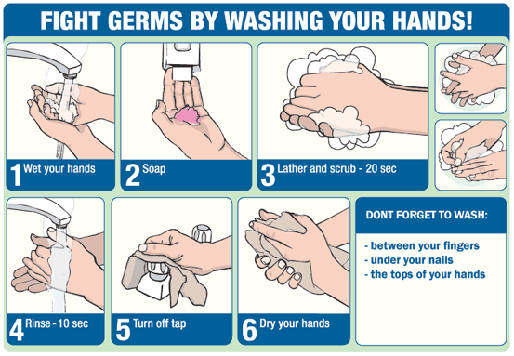
Ways To Prevent Food-borne Illness
Sanitation – Keep yourself and your kitchen clean.
What are things you should be doing before you cook for personal and kitchen cleanliness?

Slide 9
Clean Up Responsibilities
1. Dishwasher: washes all dishes, utensils, bowls, and pans. Clean out the drain.
2. Dryer: Dry all dishes, bowls, utensils and pans! Dry the sink out last. Put dirty towels in washing machine. Put 2 fresh towels and a wash cloth out.
3. Put Away: Put away all utensils and equipment in the proper place in the kitchen.

Slide 10
4. Counters and Stove: Disinfect with kitchen spray, wipe down with a clean wash cloth. Place dirty cloth in the washing machine.
5. Tables: Set tables on eating days. Disinfect table with kitchen spray.
6. Floors: Sweep floor. Pick up dirt with a dust pan and brush. Wipe up any spills in your kitchen immediately.

